Slide 1
CS 115 Libraries, F to C
Taken from notes by Dr. Neil Moore

Slide 2
The math library
We’ve seen how to do everything a five-function calculator can do. What about more advanced math?
That’s available in Python too.
But it’s not built-in like + and float are.
Instead it’s in a library.
  A collection of pre-written code intended to be re-used.
    Functions
    Constants
    Types (“classes”)
  The math library comes with Python.
  graphics (chapter 3) is a third-party library.
The Python math library has:
  Functions for trigonometry, logarithms, and more.
  Constants like π and e.

Slide 3
Using libraries in Python
To use a library, you must first import it.
  import math
  Put this at the very top of the program
  After header comments, before “def main():”
Then your program can use the things in the library
  Their names are library.name
  So math.log (function) and math.pi (constant)
  You call functions with parenthesized arguments
    Just like input and print
  Each function has its own rules about what its arguments are, what they mean, how many there are, etc.

Slide 4
Using libraries in Python
If the function returns a value, you use it as part of an expression
  height = math.log(size, 2)
If it does not return a value, use it as an entire statement by itself:
  random.seed()
Only import the libraries you need!
  for documentation, for efficiency, for style

Slide 5
A variation on import
You can instead import particular functions or constants specifically by writing import this way:
  from math import sin, cos, tan, pi
  List the names that you are importing, separated by commas
  Then you can use them without the “math.”
    y = sin(angle) * radius
  Saves typing if you use a function many times

Slide 6
One last variation on import
One last way to write import:
  from math import *
  It imports everything in the library
  And you don’t have to use “math.”
    num = e ** pi
  Sounds great, right? There can be a catch…
  What if next version of Python adds a new function which is the same name as one of your variables or functions?
  Your code could break! And have to be rewritten!
  Professional programmers avoid “from lib import *, because of this catch. In class we’ll use it occasionally

Slide 7
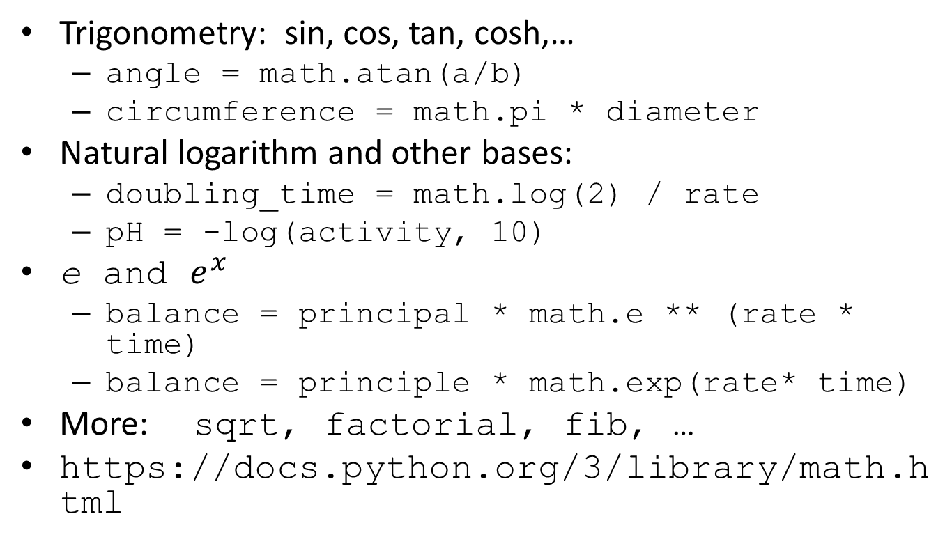
What’s in the math library
Trigonometry: sin, cos, tan, cosh,…
  angle = math.atan(a/b)
  circumference = math.pi * diameter
Natural logarithm and other bases:
  doubling_time = math.log(2) / rate
  pH = -log(activity, 10)
e and $e^{x}$
  balance = principal * math.e ** (rate * time)
  balance = principle * math.exp(rate* time)
More: sqrt, factorial, fib, …
https://docs.python.org/3/library/math.html

Slide 8
Common misunderstanding
For some reason, once people know about the math library, they feel that they MUST import it for any kind of arithmetic, using +, -, *, /, //, **, %, etc.
This is NOT the case. All these operators were available before you even knew about import, they are still available as being builtin to Python.
You need to import math ONLY when you are using math library functions (sqrt, log, …) and constants (pi, e)

Slide 9
Rounding
One more numeric function, builtin – so you do NOT have to import math library to use it
round has either one or two arguments
  If it has just ONE argument, it will round the argument to the nearest integer
    round(5.2) → 5
    round (7.9) → 8
  If it has TWO arguments, the second one is the number of decimal places desired. The first argument’s value will be rounded to that number of decimals
    round (math.pi, 2) → 3.14
    round (2.71818, 0) → 3.0
    round (12, -1) → 10

Slide 10
Rounding
One more numeric function, builtin – so you do NOT have to import math library to use it
round has either one or two arguments
  If it has just ONE argument, it will round the argument to the nearest integer
    round(5.2) → 5
    round (7.9) → 8
    round (5.235) → 5
    round (5.725) →6

Slide 11
Rounding
One more numeric function, builtin – so you do NOT have to import math library to use it
round has either one or two arguments
  If it has TWO arguments, the second one is the number of decimal places desired. The first argument’s value will be rounded to that number of decimals
    round (math.pi, 2) → 3.14
    round (2.71818, 0) → 3.0
    round (12, -1) → 10
Note that a value ending in 5 does not always round up! It rounds towards the even number – doc.python.org says that it is because of the problems with representing floating point numbers
    So that round(5.3545, 3) → 5.354 (because 4 is even)
    And round(5.3555, 3) → 5.356 (because 6 is even)
    And round(4.5) → 4, and round(5.5) → 6

Slide 12
The round function
round(number[, ndigits]) Return the floating point value number rounded to ndigits digits after the decimal point. If ndigits is omitted, it returns the nearest integer to its input.
For the built-in types supporting round(), values are rounded to the closest multiple of 10 to the power minus ndigits; if two multiples are equally close, rounding is done toward the even choice (so, for example, both round(0.5) and round(-0.5) are 0, and round(1.5) is 2). The return value is an integer if called with one argument, otherwise of the same type as number.
The behavior of round() for floats can be surprising: for example, round(2.675, 2) gives 2.67 instead of the expected 2.68. This is not a bug: it’s a result of the fact that most decimal fractions can’t be represented exactly as a float. See Floating Point Arithmetic: Issues and Limitations for more information.
From: https://docs.python.org/3/library/functions.html?highlight=round%20function#round

Slide 13
A complete program
Let’s go through the whole process of making a (simple) program, from start to finish. The steps are:
Specification (the “assignment”, usually given to you)
Test plan
Design (pseudocode, algorithm)
Writing code
Testing

Slide 14
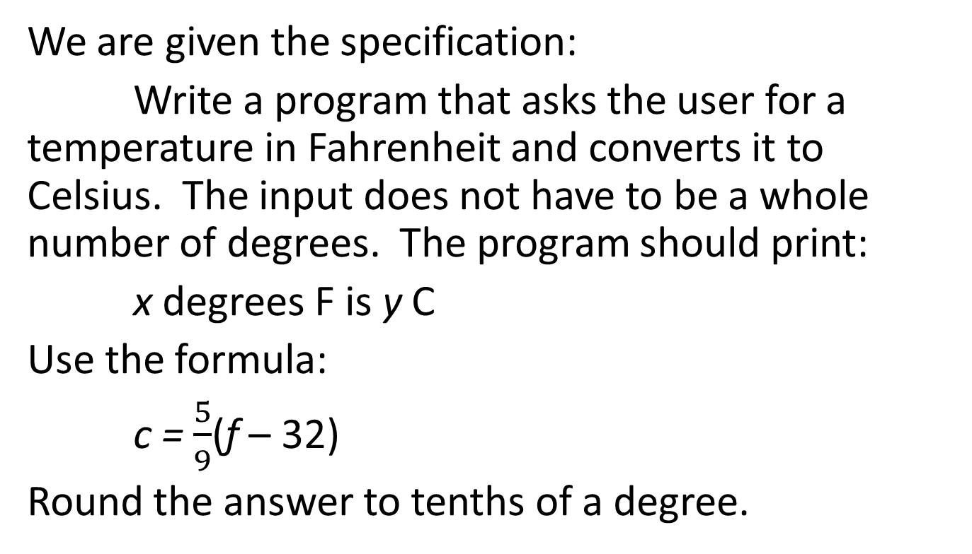
Specification
We are given the specification:
Write a program that asks the user for a temperature in Fahrenheit and converts it to Celsius. The input does not have to be a whole number of degrees. The program should print:
x degrees F is y C
Use the formula:
c = $\frac{5}{9}$(f – 32)
Round the answer to tenths of a degree.

Slide 15
Test plan
What kind of inputs to test?
Normal inputs: both integers and floats.
Are there any boundary cases?
  Not really for the formula
    Some people would argue for absolute zero (-459.67 degrees Fahrenheit or 273.15 degrees Celsius) because of physics
  Still we might test 0, should test negative numbers
Other special cases?
  If the input had more than one digit after decimal, to check for rounding correctly
Any error cases?
  Non-numeric input

Slide 16
Test plan
Description | Input | Expected output
Normal, integer | 32 | 32.0 F is 0.0 C
Normal, float | 98.6 | 98.6 F is 37.0 C
Normal, zero | 0.0 | 0.0 F is -17.8 C
Normal, negative | -40 | -40.0 F is -40.0 C
Normal, absolute zero | -459.67 | -459.67 F is -273.2 F
Special, to check rounding | 0.33333 | 0.3 F is -17.6 C
Error, non-numeric input | Zero | Terminates with error message about wrong type

Slide 17
Design
For the design, we start with the purpose, inputs (preconditions) and outputs (postconditions).
Purpose: Convert a temperature from Fahrenheit to Celsius.
Preconditions: User enters a temperature in Fahrenheit.
Postconditions: Program prints the message “x F is y C.”, rounded to one digit after the decimal point.

Slide 18
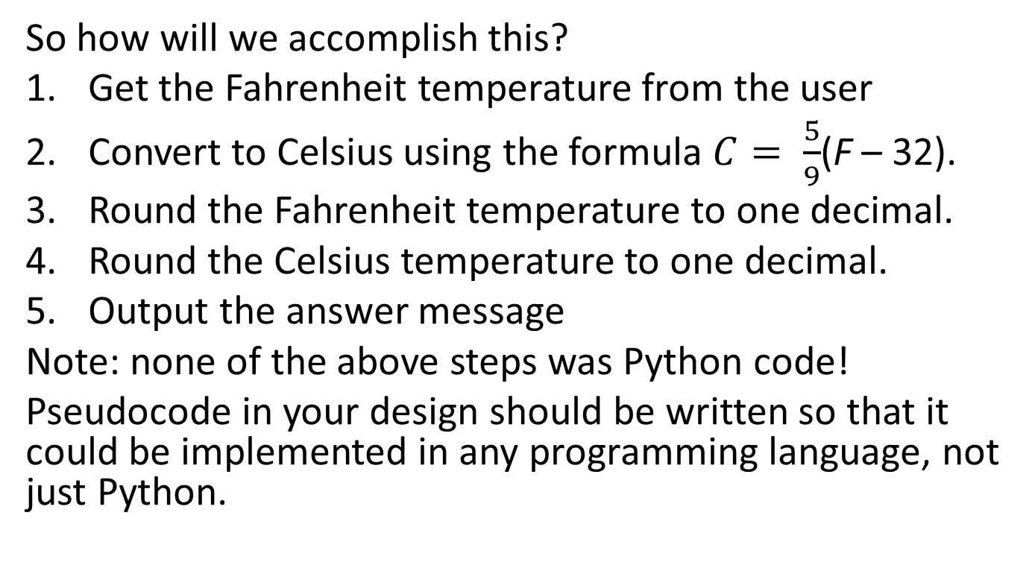
Pseudocode
So how will we accomplish this?
Get the Fahrenheit temperature from the user
Convert to Celsius using the formula $C= \frac{5}{9}$(F – 32).
Round the Fahrenheit temperature to one decimal.
Round the Celsius temperature to one decimal.
Output the answer message
Note: none of the above steps was Python code!
Pseudocode in your design should be written so that it could be implemented in any programming language, not just Python.

Slide 19
Pseudocode to comments
Make each step into a comment.
#Purpose: Convert a temperature from Fahrenheit to
# Celsius.
#Preconditions: User enters a temperature in Fahrenheit.
#Postconditions: Program prints the message “x F is y C.”,
# rounded to one digit after the decimal point.
# 1. Get the Fahrenheit temperature from the user
# 2. Convert to Celsius using the formula C = 5/9 (F – 32)
# 3. Round the Fahrenheit temperature to one decimal.
# 4. Round the Celsius temperature to one decimal.
# 5. Output the answer message.

Slide 20
Writing the code
Put the steps inside a def main(): and call the main function at the end.
# Purpose: Convert a temperature from Fahrenheit to
# Celsius.
#Preconditions: User enters a temperature in Fahrenheit.
#Postconditions: Program prints the message “x F is y C.”,
# rounded to one digit after the decimal point.
def main():
# 1. Get the Fahrenheit temperature from the user
# 2. Convert to Celsius using the form. C = 5/9 (F – 32)
# 3. Round the Fahrenheit temperature to one decimal.
# 4. Round the Celsius temperature to one decimal.
# 5. Output the answer message.
main()

Slide 21
Writing the code
And write code for each line of the design.
def main():
# 1. Get the Fahrenheit temperature from the user
fahr = float(input(“Enter a temp in Fahrenheit: “))
# 2. Convert to Celsius using the form. C = 5/9 (F – 32)
celsius = (5/9) * (fahr – 32)
# 3. Round the Fahrenheit temperature to one decimal.
fahr_round = round(fahr, 1)
# 4. Round the Celsius temperature to one decimal.
cels_round = round(celsius, 1)
# 5. Output the answer message.
print(fahr_round, “F is”, cels_round, “C.”)
main()

Slide 22
Testing
Now run the program once for each test case.
Give the input and verify that the output matches the expected output.
If not, there is a bug:
  Maybe in your program…
  Maybe in your test case!
After you fix a bug, repeat all the tests.
  Regression testing!

